Slide 1
Modeling Forest Malaria Using a Time-at-Risk Based Approach
Incorporating Human Movement into the Equation
Alec Georgoff
MMC Meeting, Bangkok, Thailand
November 29, 2018
Notes:
Draw picture of malaria life cycle
More background
Why are we doing this?

Slide 2
Background
What makes forest malaria different?
Risk is spread across different “populations” based on time spent in certain locations
Forest-going population has different risk than those who stay in village
Transmission is occurring away from home
People who travel form a different population

Slide 3
Contrasting Malaria Models
Ross-Macdonald Model
Entire human population exposed to the same mosquito population
One transmission location
Forest Model
Transmission occurs at home and away from home
Multiple human populations exposed to multiple mosquito populations

Slide 4
Reproductive Rate

Slide 5
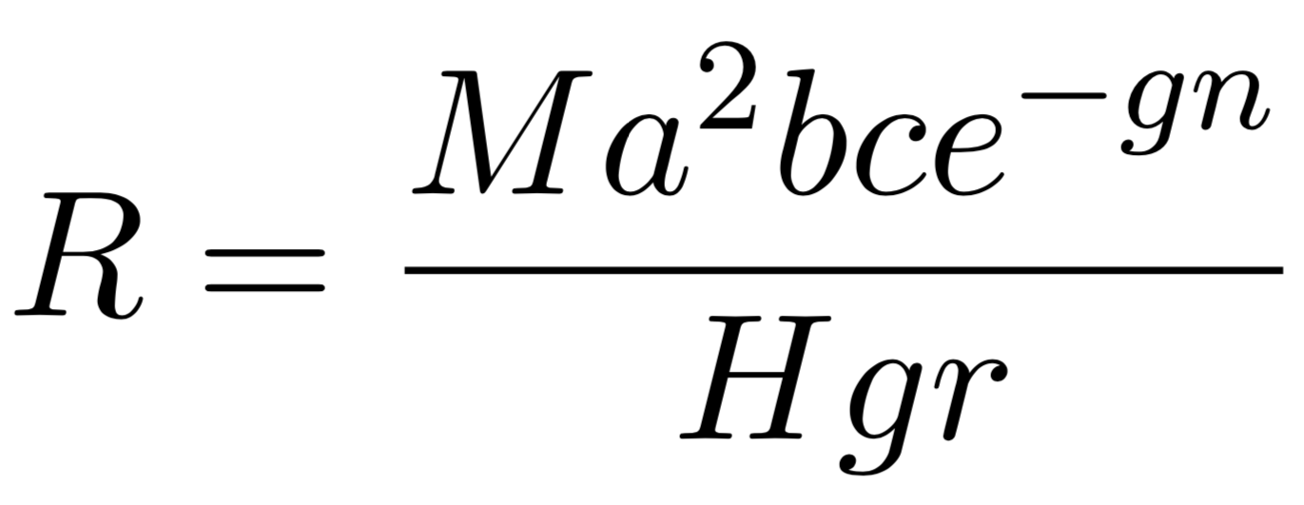
Reproductive Rate
Mosquitoes Per Human
Notes:
Combines environmental parameters into one summary parameter
Threshold for elimination
Epi meaning of R
How it’s different in these systems
Local reproductive rate is different between forests and villages

Slide 6
Reproductive Rate
Mosquito Biting Rate
Notes:
Combines environmental parameters into one summary parameter
Threshold for elimination
Epi meaning of R
How it’s different in these systems
Local reproductive rate is different between forests and villages

Slide 7
Reproductive Rate
Proportion of Bites That Cause Infection
Notes:
Combines environmental parameters into one summary parameter
Threshold for elimination
Epi meaning of R
How it’s different in these systems
Local reproductive rate is different between forests and villages

Slide 8
Reproductive Rate
Proportion of Bites That Cause Infection
Notes:
Combines environmental parameters into one summary parameter
Threshold for elimination
Epi meaning of R
How it’s different in these systems
Local reproductive rate is different between forests and villages

Slide 9
Reproductive Rate
Time for Sporogonic Cycle
Notes:
Combines environmental parameters into one summary parameter
Threshold for elimination
Epi meaning of R
How it’s different in these systems
Local reproductive rate is different between forests and villages

Slide 10
Reproductive Rate
Mosquito Death Rate
Notes:
Combines environmental parameters into one summary parameter
Threshold for elimination
Epi meaning of R
How it’s different in these systems
Local reproductive rate is different between forests and villages

Slide 11
Reproductive Rate
Human Disease Recovery
Notes:
Combines environmental parameters into one summary parameter
Threshold for elimination
Epi meaning of R
How it’s different in these systems
Local reproductive rate is different between forests and villages

Slide 12
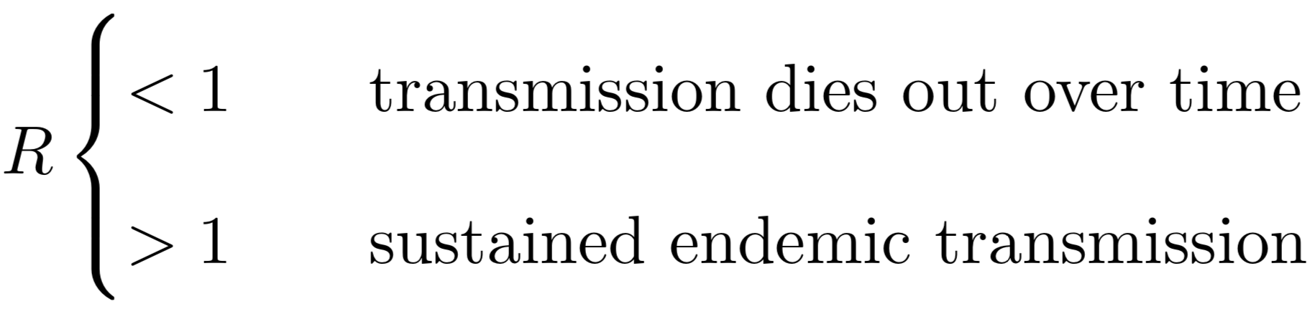

Reproductive Rate
Notes:
Combines environmental parameters into one summary parameter
Threshold for elimination
Epi meaning of R
How it’s different in these systems
Local reproductive rate is different between forests and villages

Slide 13
Time-at-Risk

Slide 14
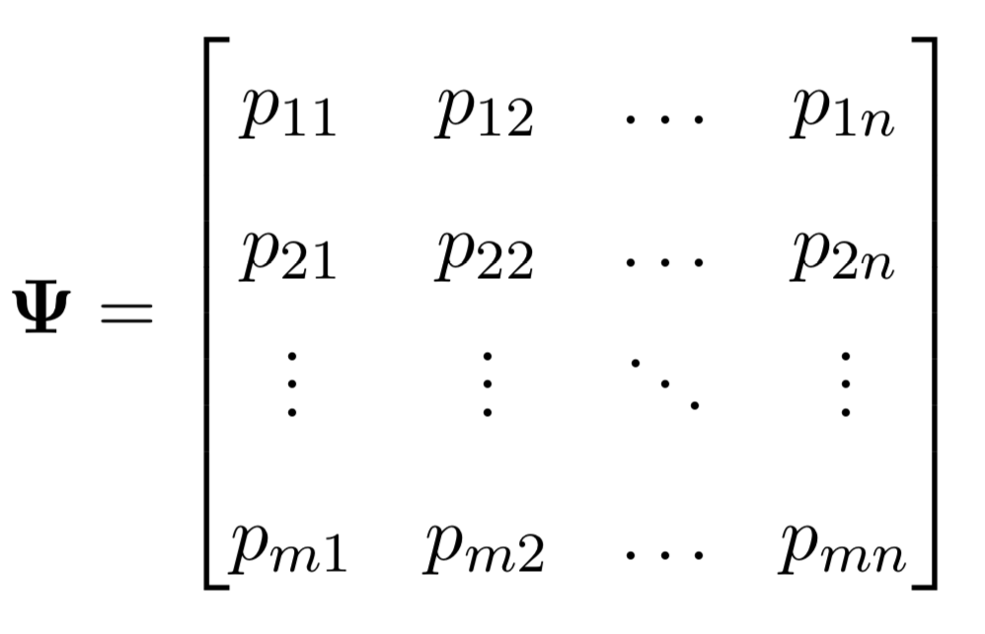
Time-at-Risk (TaR)
Rows Sum to 1
Notes:
Describes how people spend their time
Each row sums to one

Slide 15
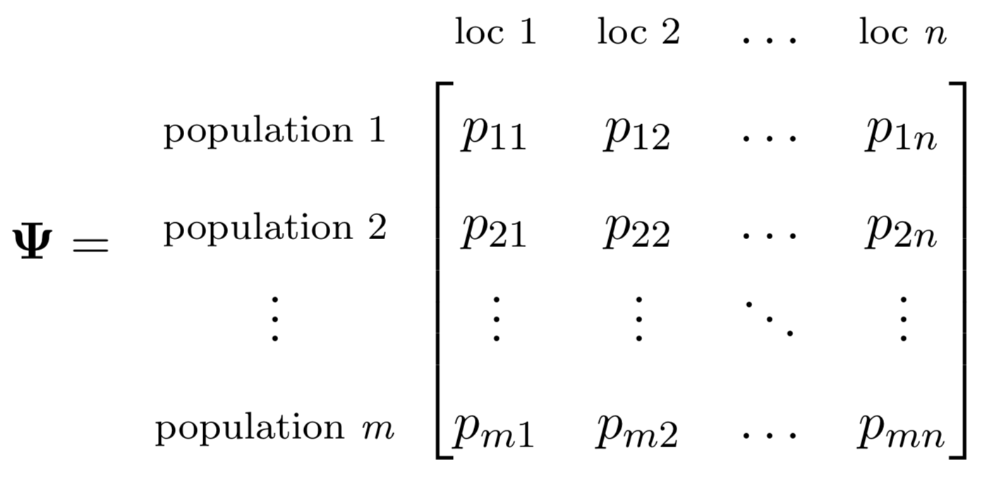
Time-at-Risk (TaR)
Rows Sum to 1
Notes:
Describes how people spend their time
Each row sums to one

Slide 16
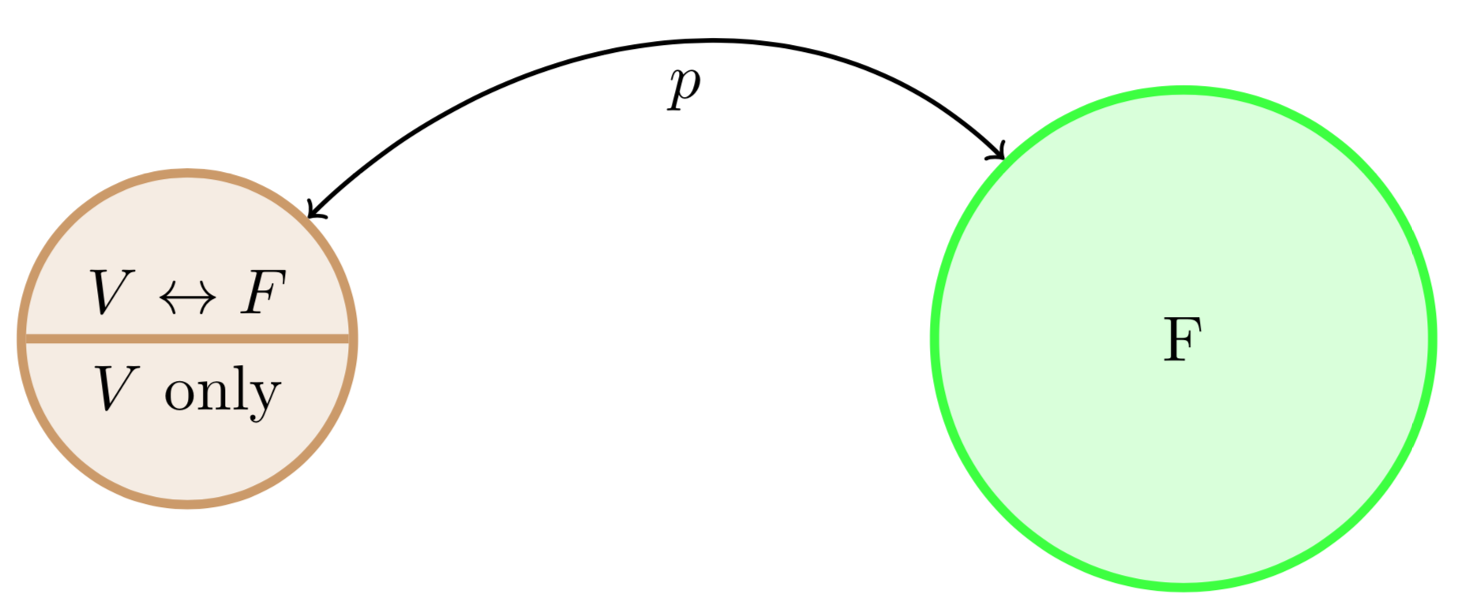
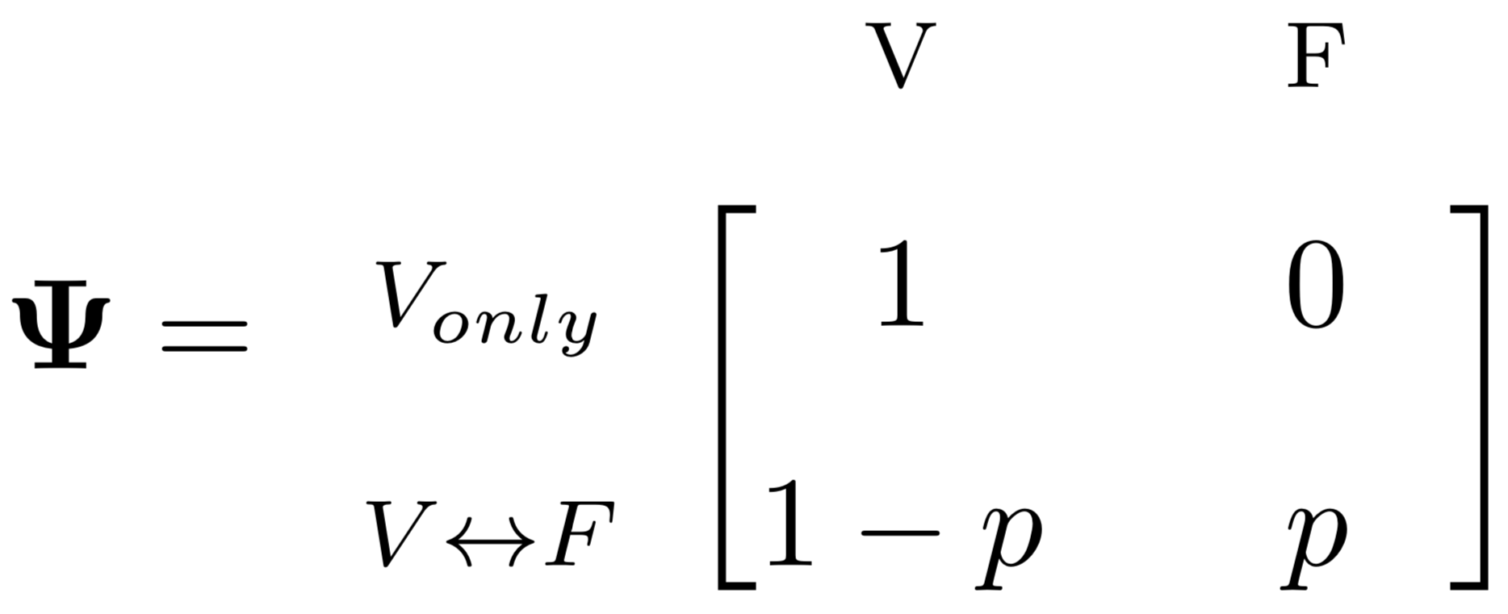
Time-at-Risk (TaR)
Notes:
Simplest possible example
Walk through psi matrix

Slide 17
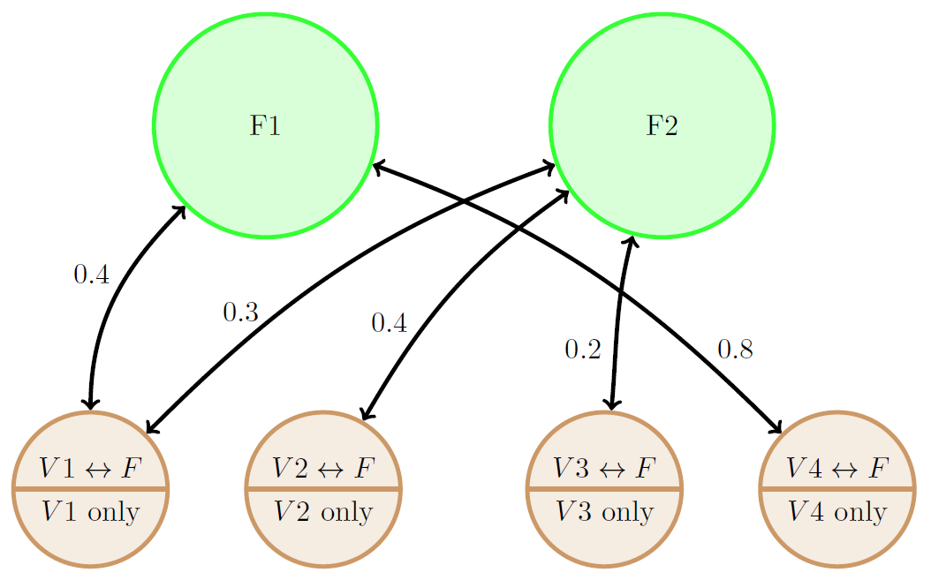
Time-at-Risk (TaR)
Notes:
Populations can travel to multiple forests

Slide 18
Time-at-Risk (TaR)

Slide 19
Time-at-Risk (TaR)

Slide 20
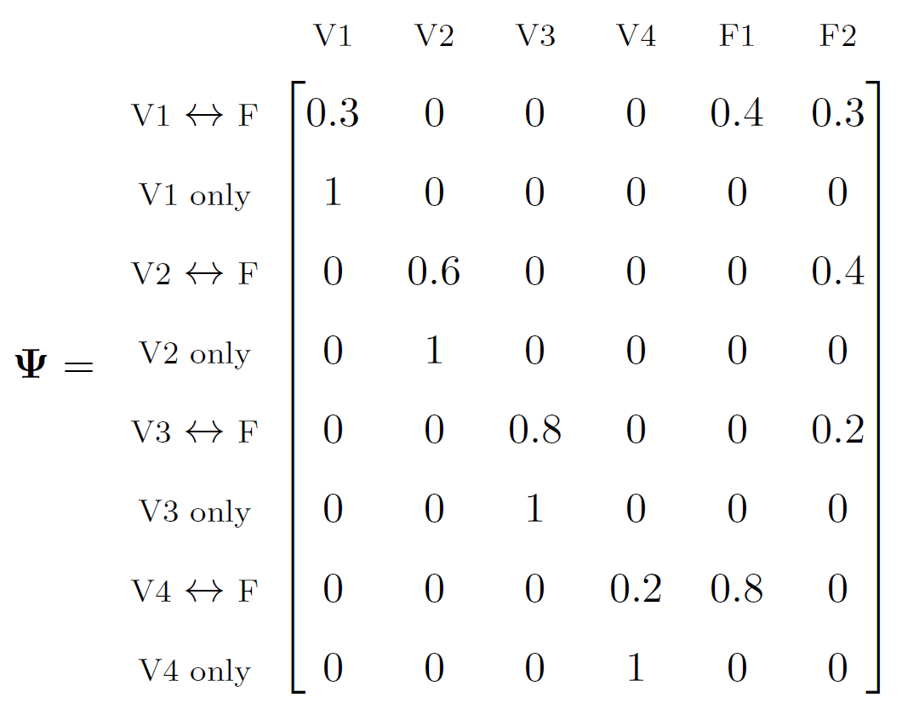
Time-at-Risk (TaR)
Notes:
Rows add up to 1
The p values are what’s really important here
Tie it all to *real* situations

Slide 21
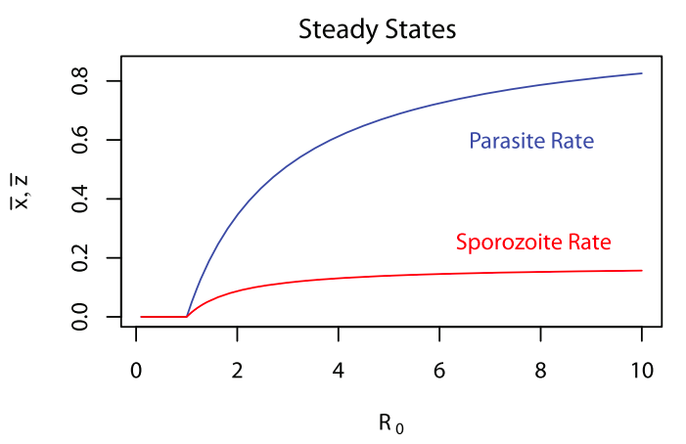
Traditional Model
Notes:
Use my model to plot the same thing and show how it’s different (higher R in forest)

Slide 22
Time-at-Risk Model

Slide 23
Visualizations

Slide 24
Visualizations
Heatmap
3D Surface
Notes:
Simple example gives us some cool visualizations

Slide 25
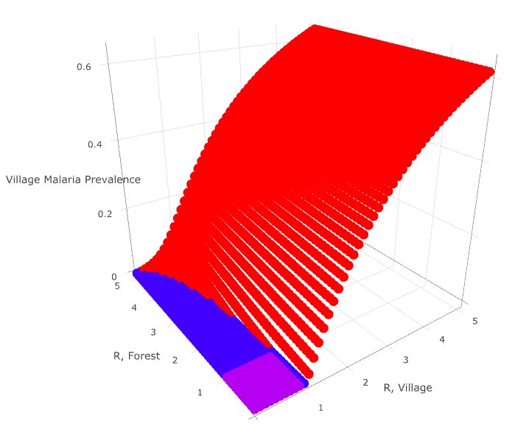
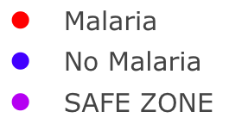
Visualizations
p = 0.2

Slide 26
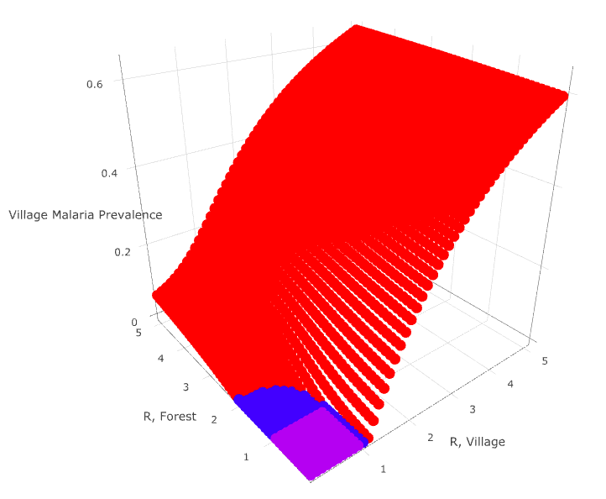
Visualizations
p = 0.5

Slide 27
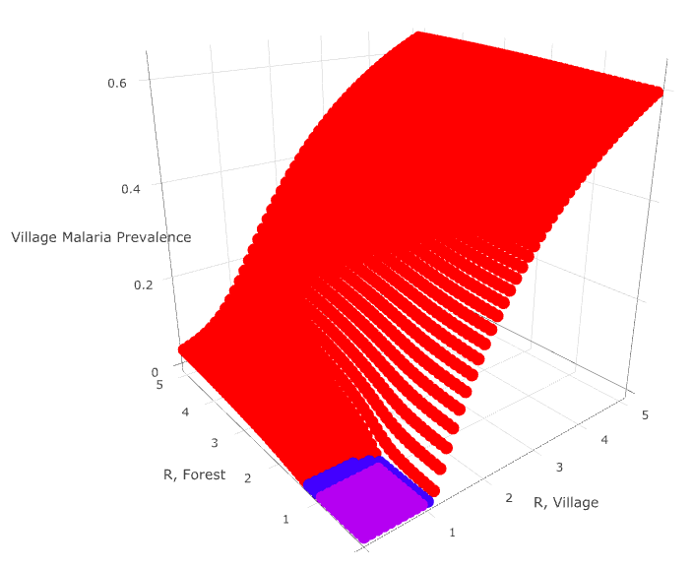
Visualizations
p = 0.8

Slide 28
Next Steps

Slide 29
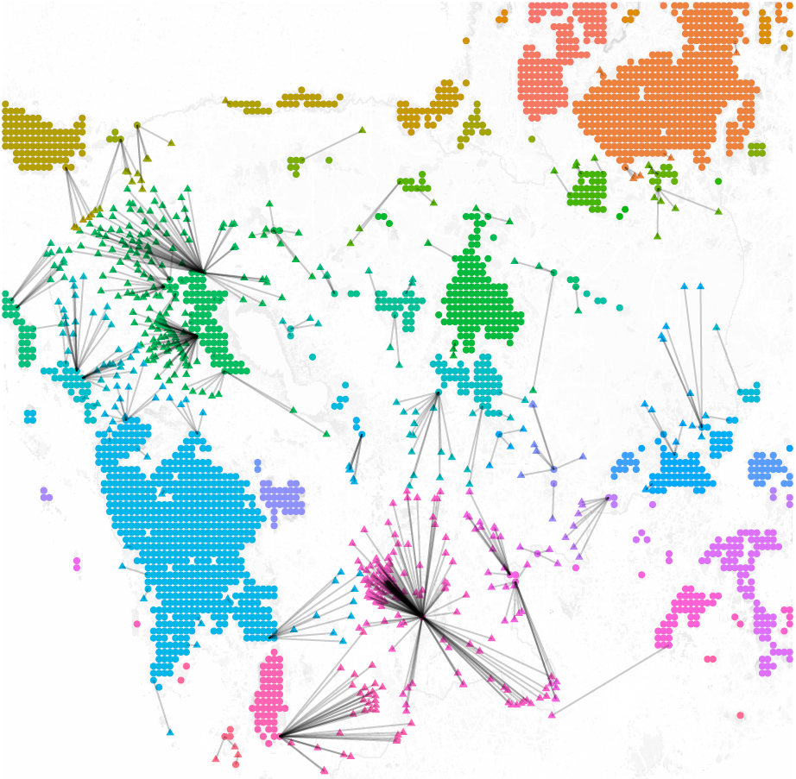
Data, Data, Data
Satellite landcover data,
OSM village locations,
Friction travel surface
Notes:
Attempt to use high level, publicly available data – not super believable
Creating populations of people that are linked by transmission in forests
Understanding these networks will allow us to better tailor interventions
*we can estimate these quantities*
How do we take complicated data on travel and incorporate it into TaR

Slide 30
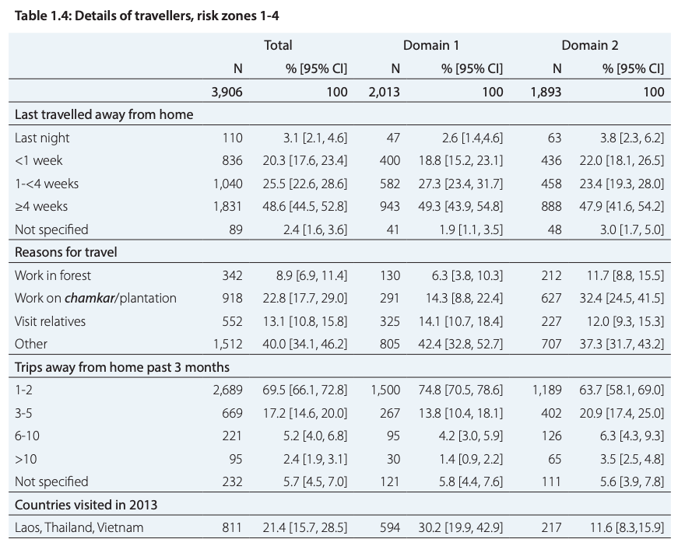
Data, Data, Data
Cambodia Malaria Survey 2013
Notes:
Attempt to use high level, publicly available data – not super believable
Creating populations of people that are linked by transmission in forests
Understanding these networks will allow us to better tailor interventions
*we can estimate these quantities*
How do we take complicated data on travel and incorporate it into TaR

Slide 31
Data, Data, Data
Notes:
Attempt to use high level, publicly available data – not super believable
Creating populations of people that are linked by transmission in forests
Understanding these networks will allow us to better tailor interventions
*we can estimate these quantities*
How do we take complicated data on travel and incorporate it into TaR

Slide 32
Questions?

Slide 33
Objectives

Slide 34
Objectives
Mathematical
Underpinnings
The basics of mosquito math
Vector-Based
Approach
Multiple locations in one equation
Simple
Example
One village, one forest
Expanded
Example
More villages, more forests!!
R
Implementation
Making computers do the hard math

Slide 35
Objectives
Visualizations
Seeing is believing
Future Directions
Our plans moving forward

Slide 36
Mathematical Underpinnings

Slide 37
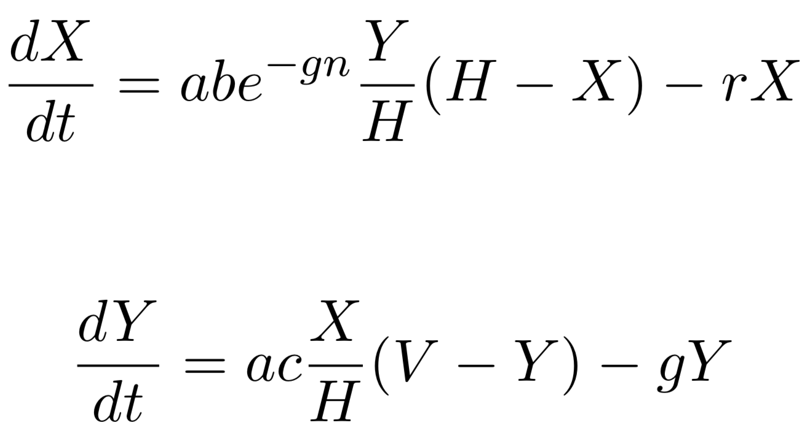
Ross-Macdonald Equations
Infected Humans
Infected Mosquitoes
Notes:
Two equations link together two key parameters (X and Y)
Change V to M
Graphs of RM equations

Slide 38
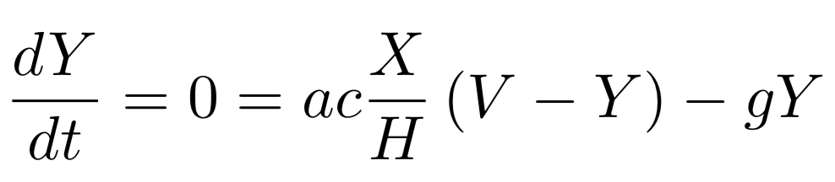
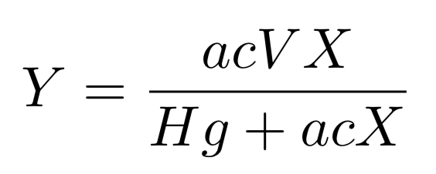
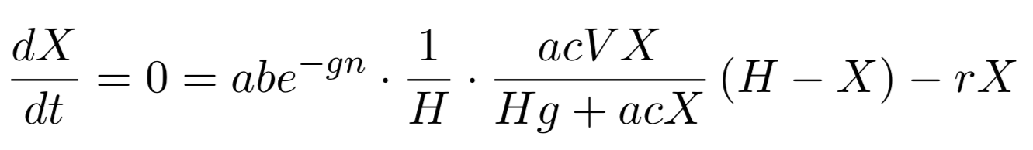
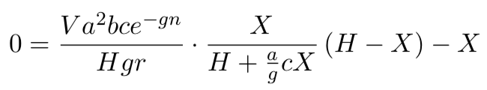
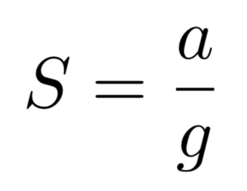
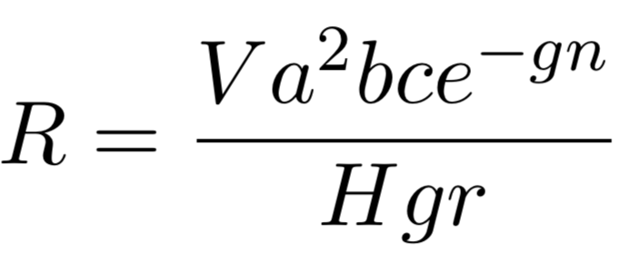
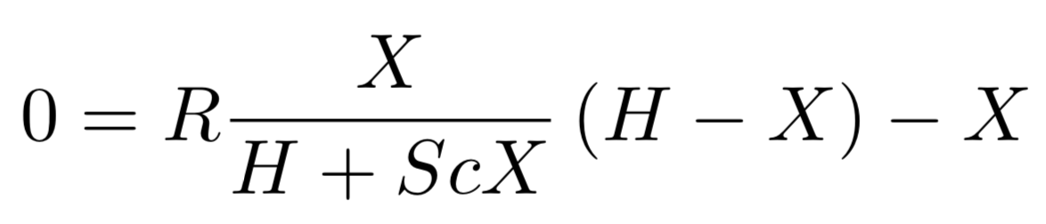
Equilibrium Assumptions
Notes:
Key takeaway: assuming steady state, we can relate X and R in one equation

Slide 39
Equilibrium Assumptions

Slide 40
Equilibrium Assumptions

Slide 41
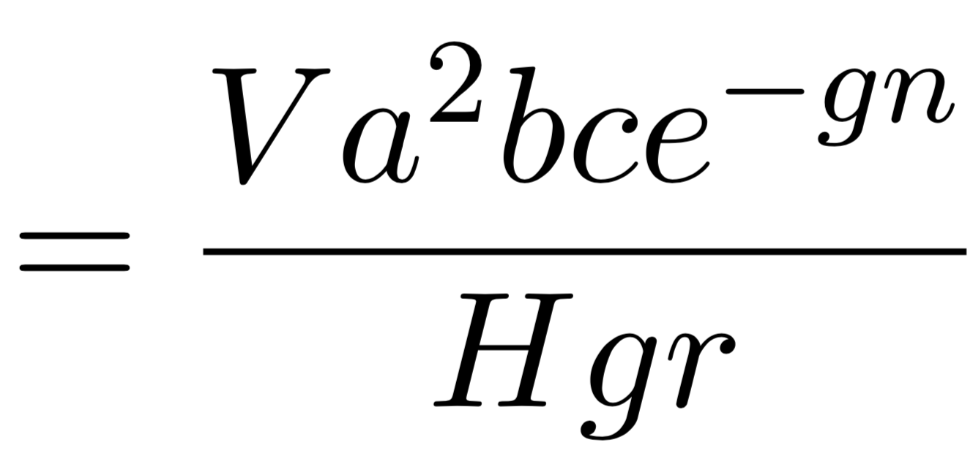
Reproductive Rate
Notes:
Combines environmental parameters into one summary parameter
Threshold for elimination
Epi meaning of R
How it’s different in these systems
Local reproductive rate is different between forests and villages

Slide 42
Multi-Site Approach
Notes:
Use vectors to store values of the same variable in different places
Use “multi patch” or “multi site”

Slide 43
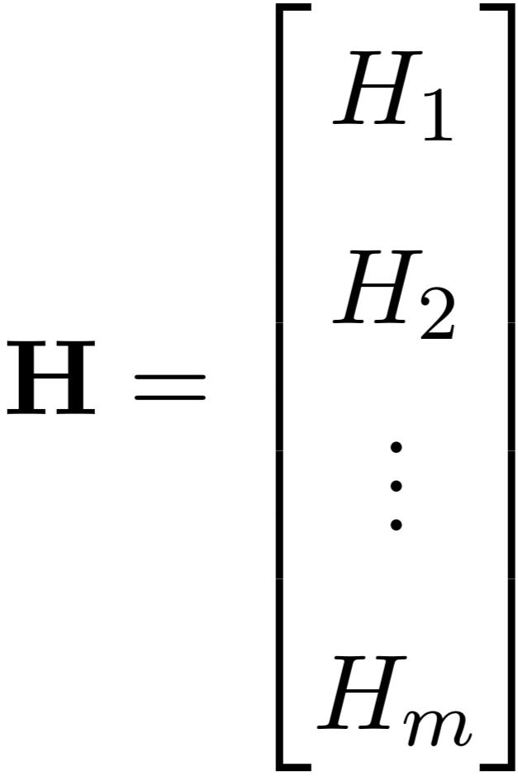
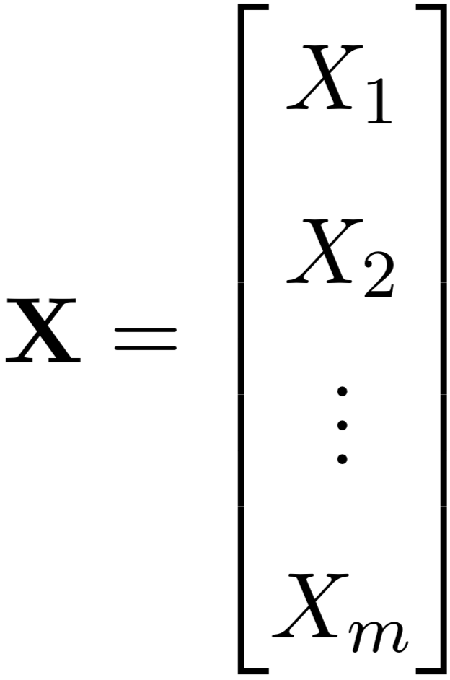
Multi-Site Variables
Notes:
Add picture

Slide 44
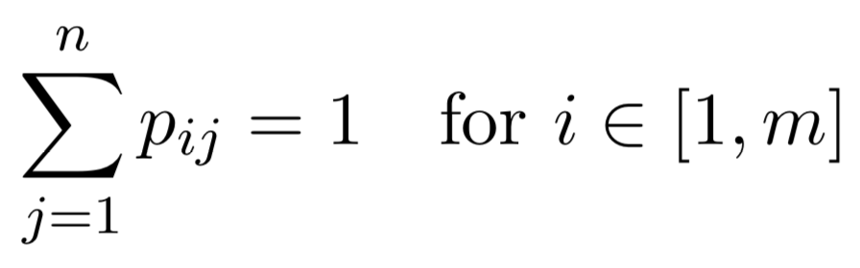
Time-at-Risk (TaR)
Notes:
Describes how people spend their time
Each row sums to one

Slide 45
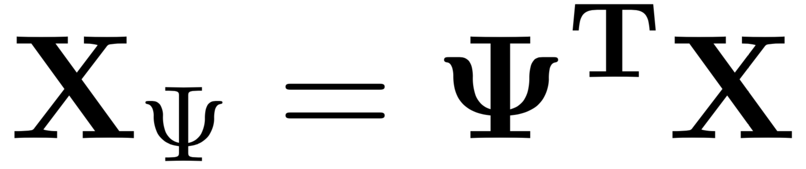

Scaling by Time-at-Risk
Notes:
Can now use psi to scale by time at risk

Slide 46
Ross-Macdonald Equations
Notes:
Back to RM equations from before

Slide 47
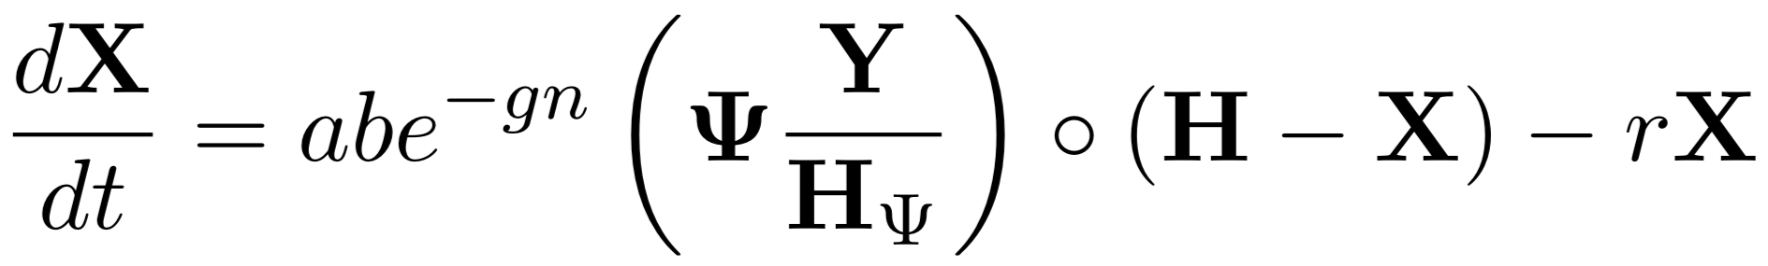
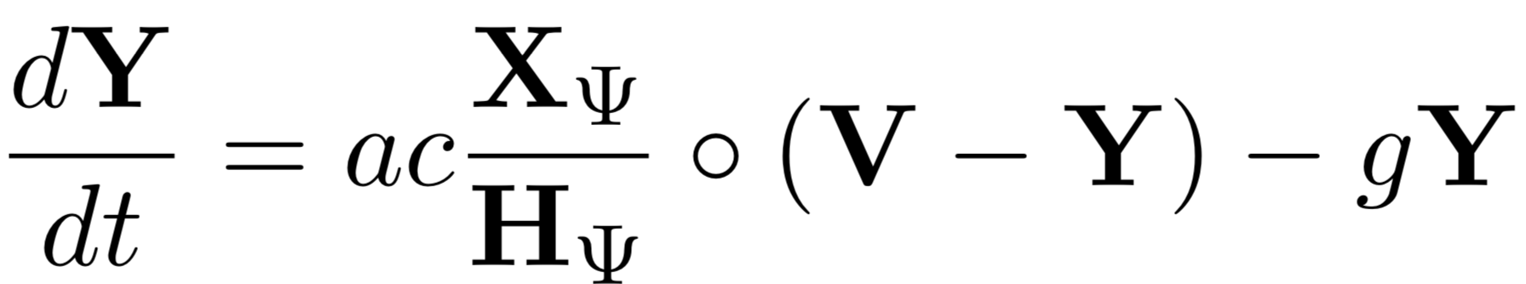
Ross-Macdonald Equations
Notes:
…converted to use vectors and psi matrix

Slide 48
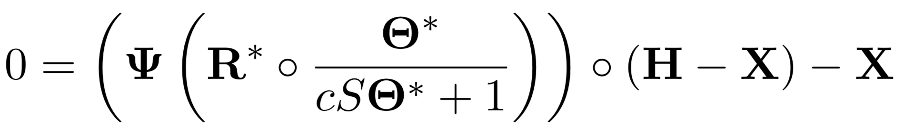
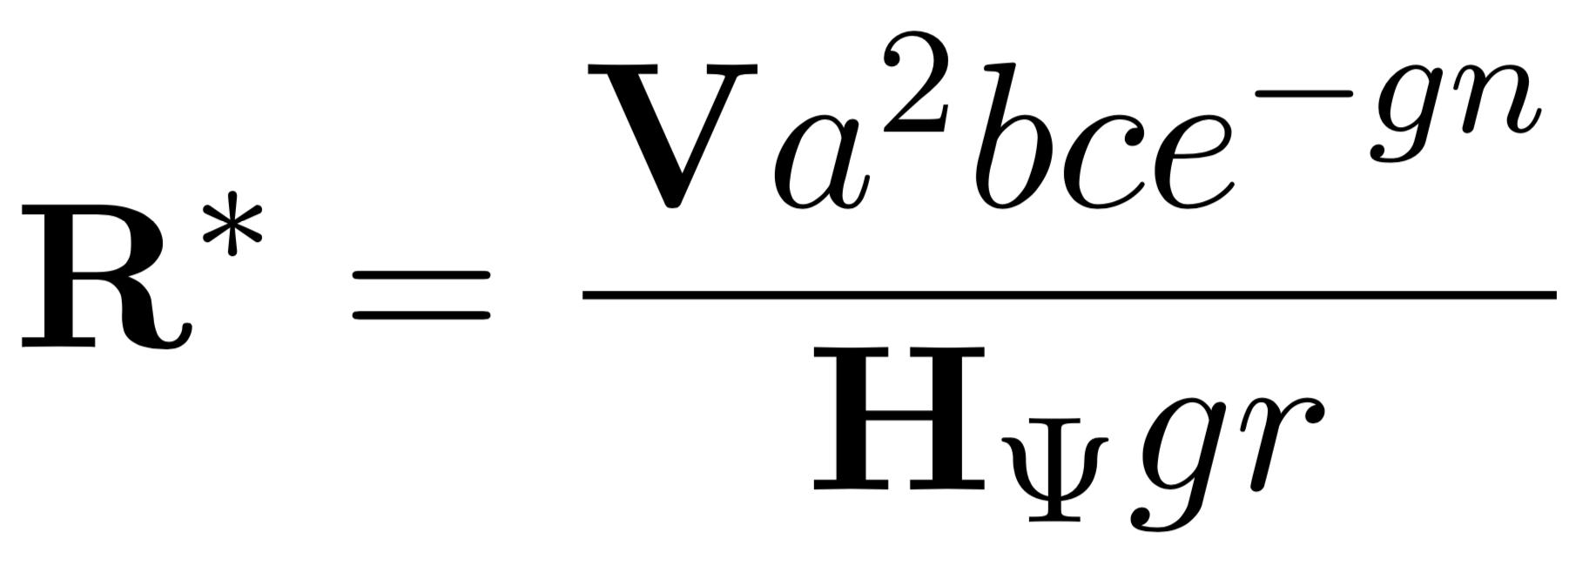
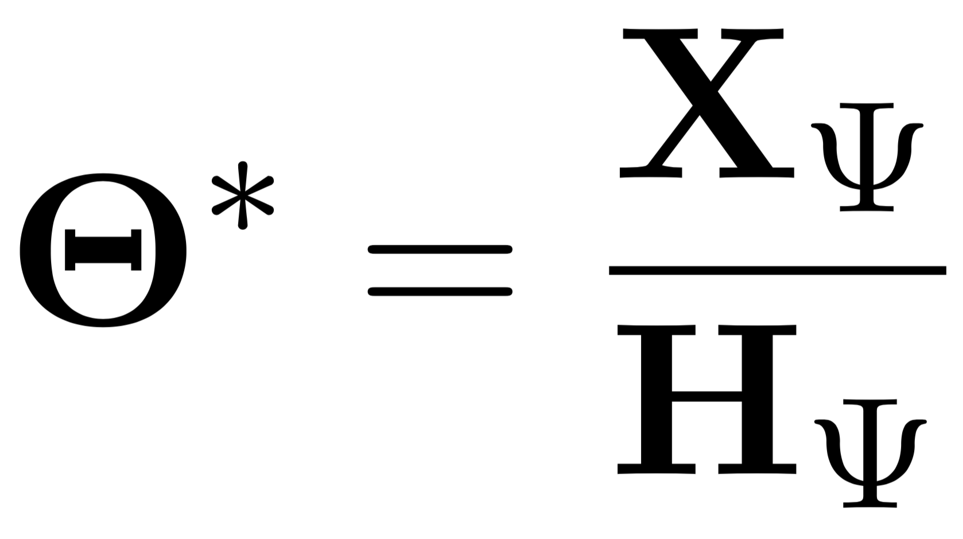
Equilibrium Assumptions
Notes:
Using same steady state assumptions as before, we get equation relating X and R

Slide 49
(Not) Simple Example

Slide 50
Simple Example: One Village, One Forest
Notes:
Simplest possible example
Walk through psi matrix

Slide 51
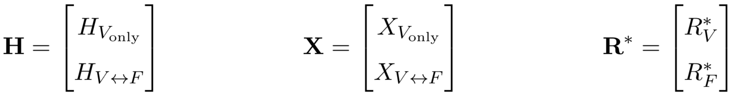
Simple Example: One Village, One Forest

Slide 52
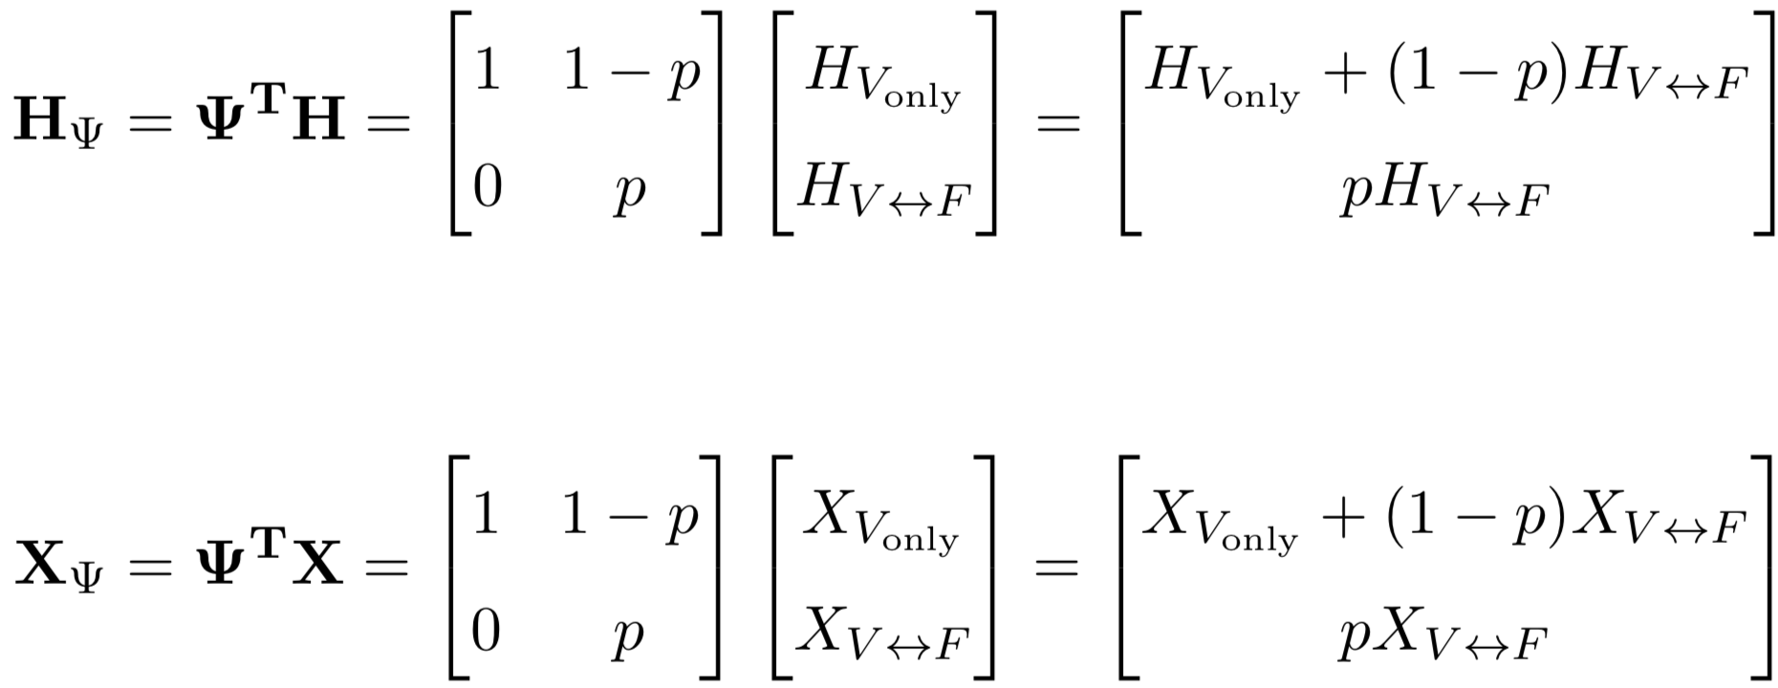
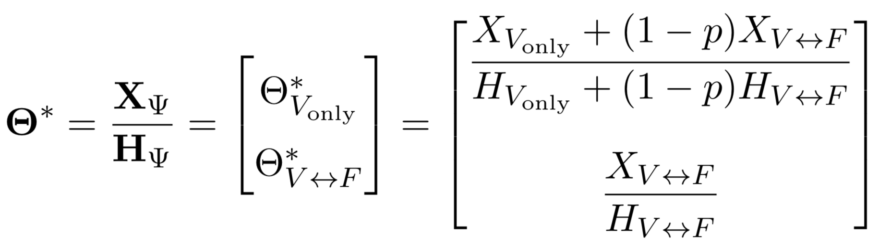
Simple Example: One Village, One Forest
Notes:
Show how populations are scaled

Slide 53
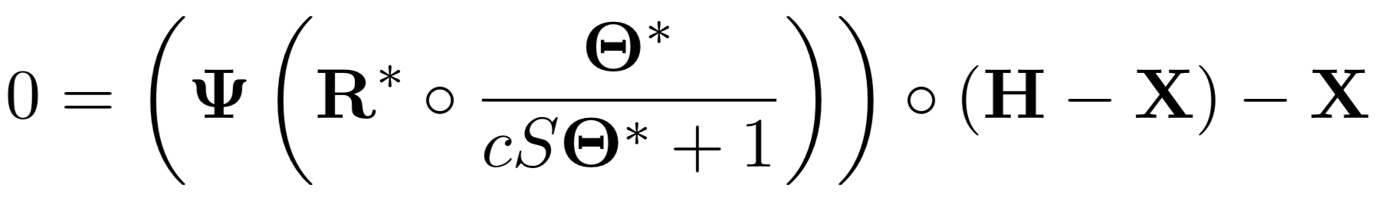
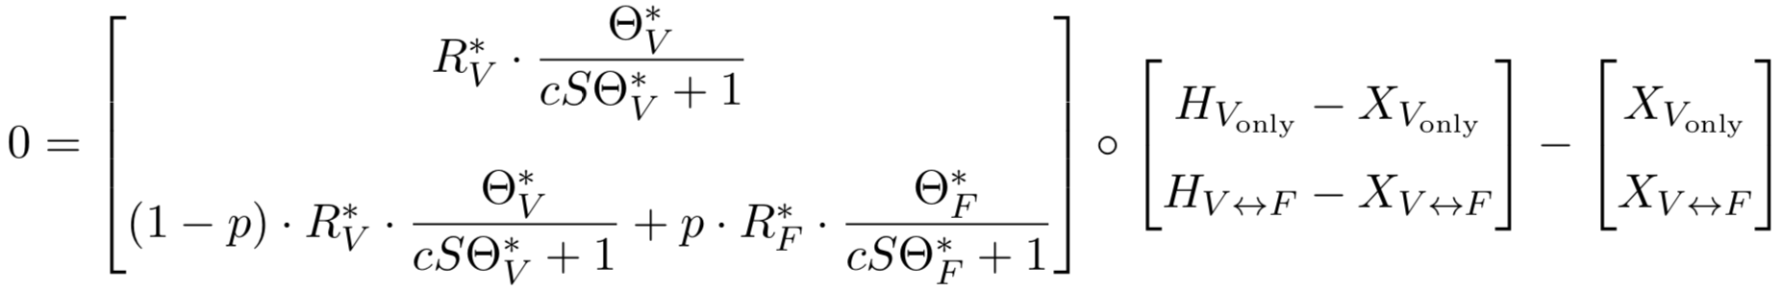
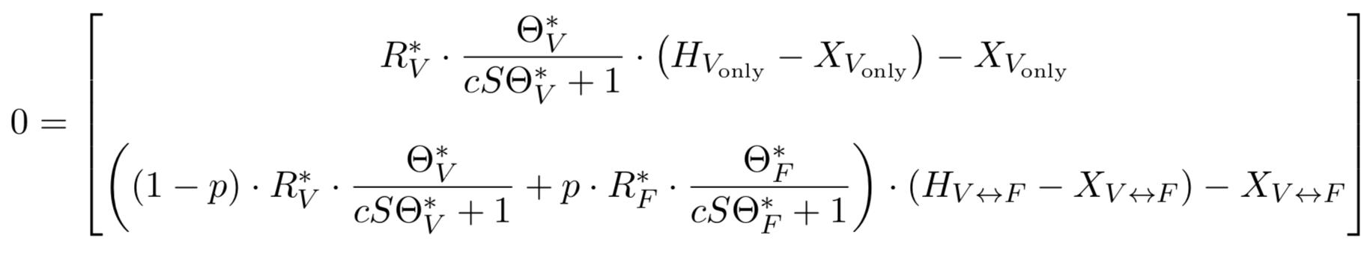
Simple Example: One Village, One Forest
Notes:
Once again relating R and X

Slide 54
Expanded Example

Slide 55
Expand to More Villages and Forests
Notes:
Populations can travel to multiple forests

Slide 56
Expand to More Villages and Forests

Slide 57
Expand to More Villages and Forests

Slide 58
Expand to More Villages and Forests
Notes:
Rows add up to 1
The p values are what’s really important here
Tie it all to *real* situations

Slide 59
Implementation In R

Slide 60
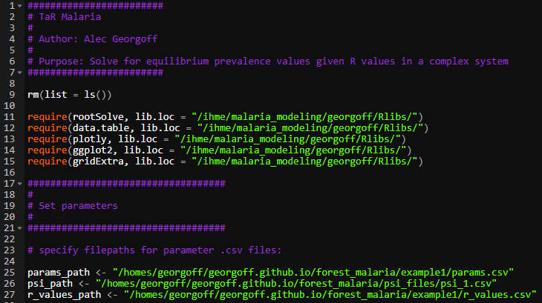
R Code

Slide 61
R Code
Notes:
Parameters are stored in CSVs

Slide 62
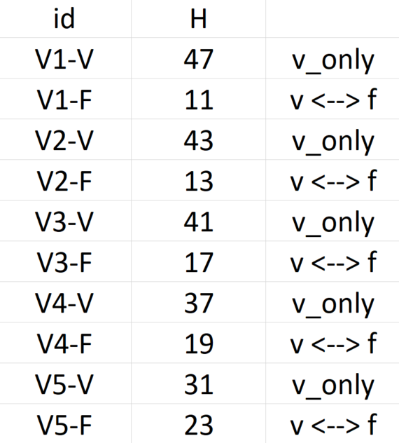
R Code – Parameters
Notes:
UNIQUE human populations

Slide 63
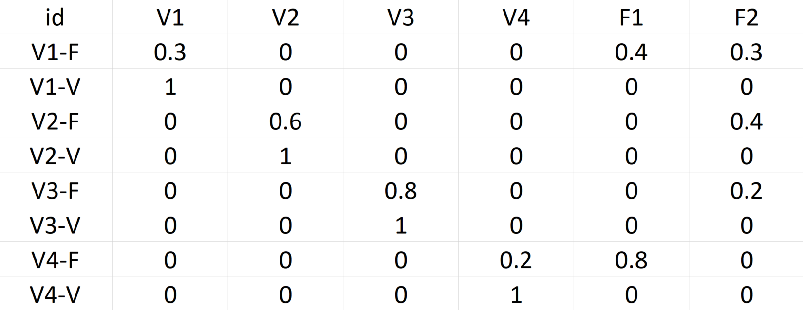
R Code – TaR Matrix
Notes:
TaR matrix

Slide 64
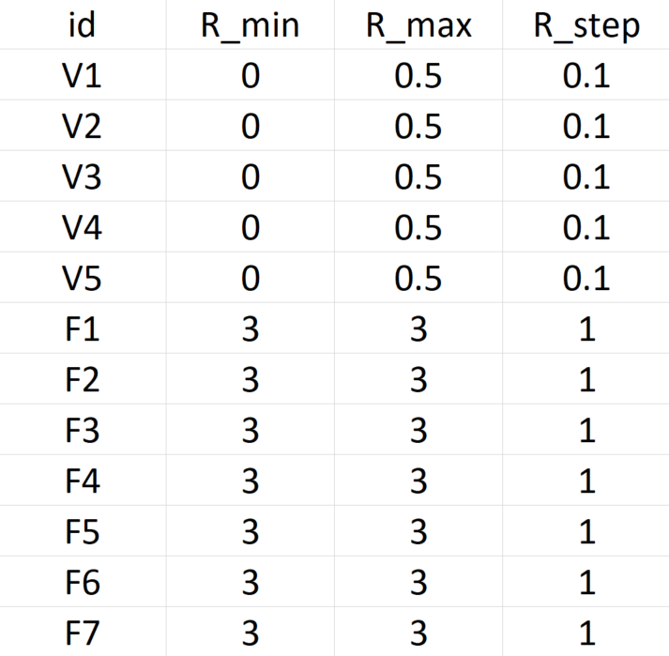
R Code – R Values
Notes:
Explain R ranges and permutations

Slide 65
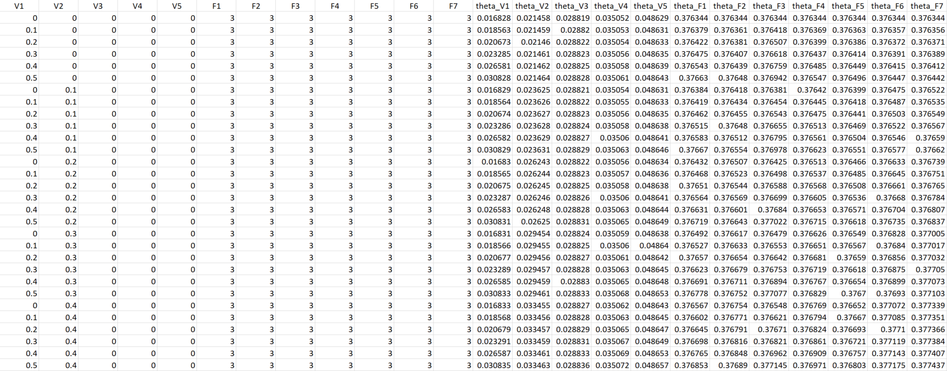
R Code – Results
7776 Rows

Slide 66
Visualizations

Slide 67
Visualizations
Heatmap
3D Surface
Notes:
Simple example gives us some cool visualizations

Slide 68
Visualizations
3 plots of surfaces and heatmaps at different R values

Slide 69
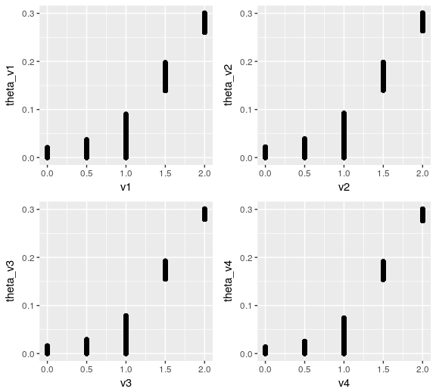
Visualizations
Notes:
Need to do more work on visualizing in higher dimensions

Slide 70
Future Directions

Slide 71
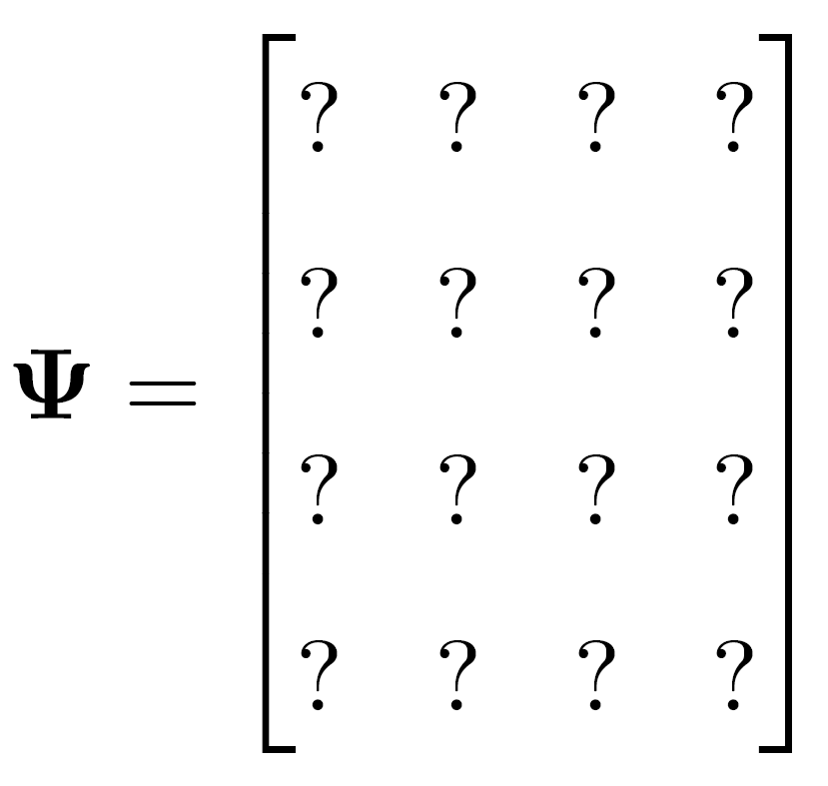
Data, Data, Data
Notes:
TaR matrix is key missing piece
Tie new sources of data to this

Slide 72
Data, Data, Data
Notes:
Attempt to use high level, publicly available data – not super believable
Creating populations of people that are linked by transmission in forests
Understanding these networks will allow us to better tailor interventions
*we can estimate these quantities*
How do we take complicated data on travel and incorporate it into TaR

Slide 73

Model Interface
Notes:
Shiny interface

Slide 74

Questions?

Slide 75
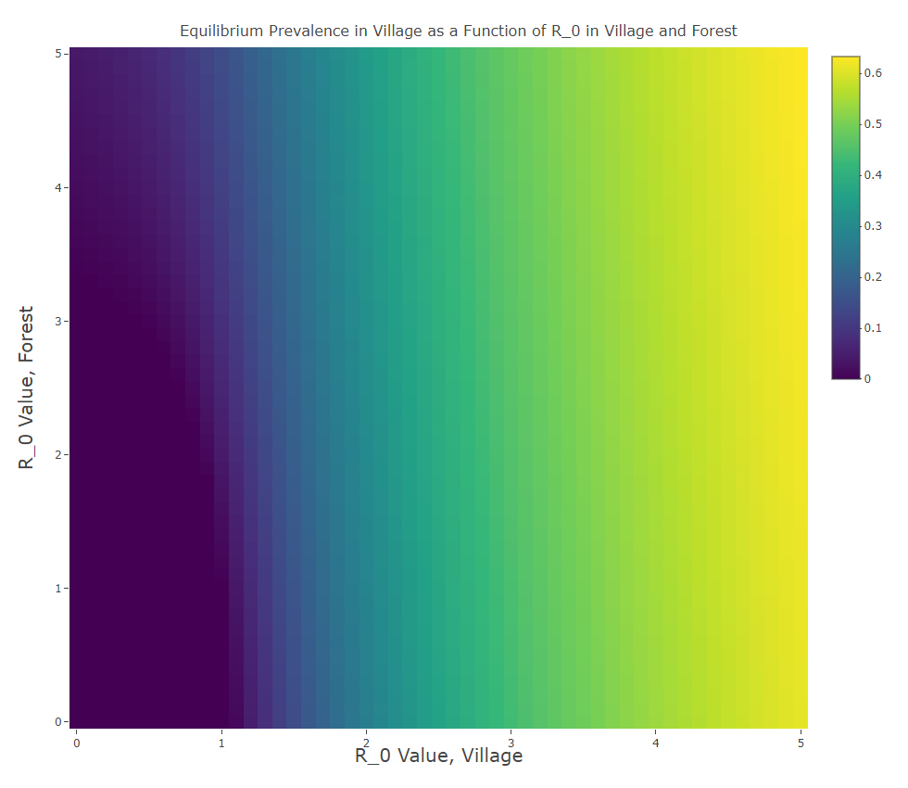

Slide 76
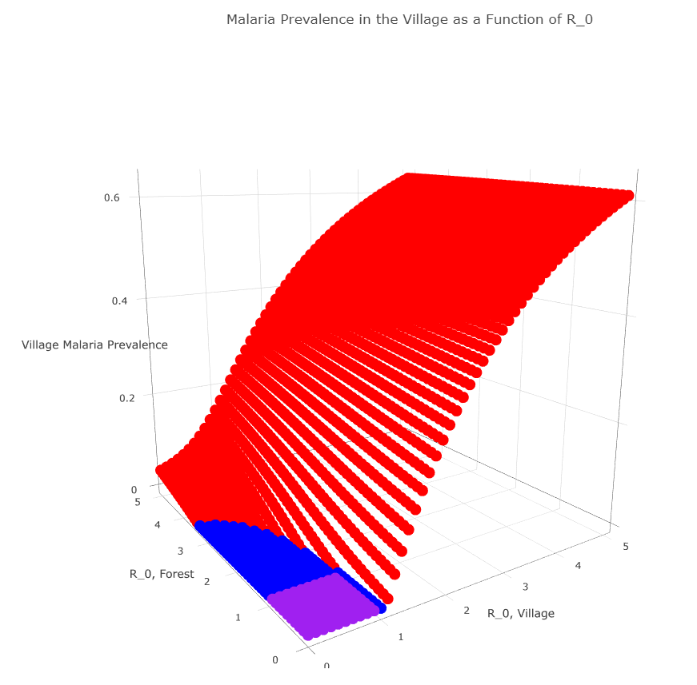

Slide 77

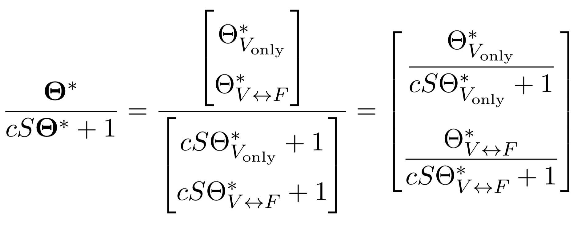
Simple Example: One Village, One Forest
Notes:
delete

Slide 78
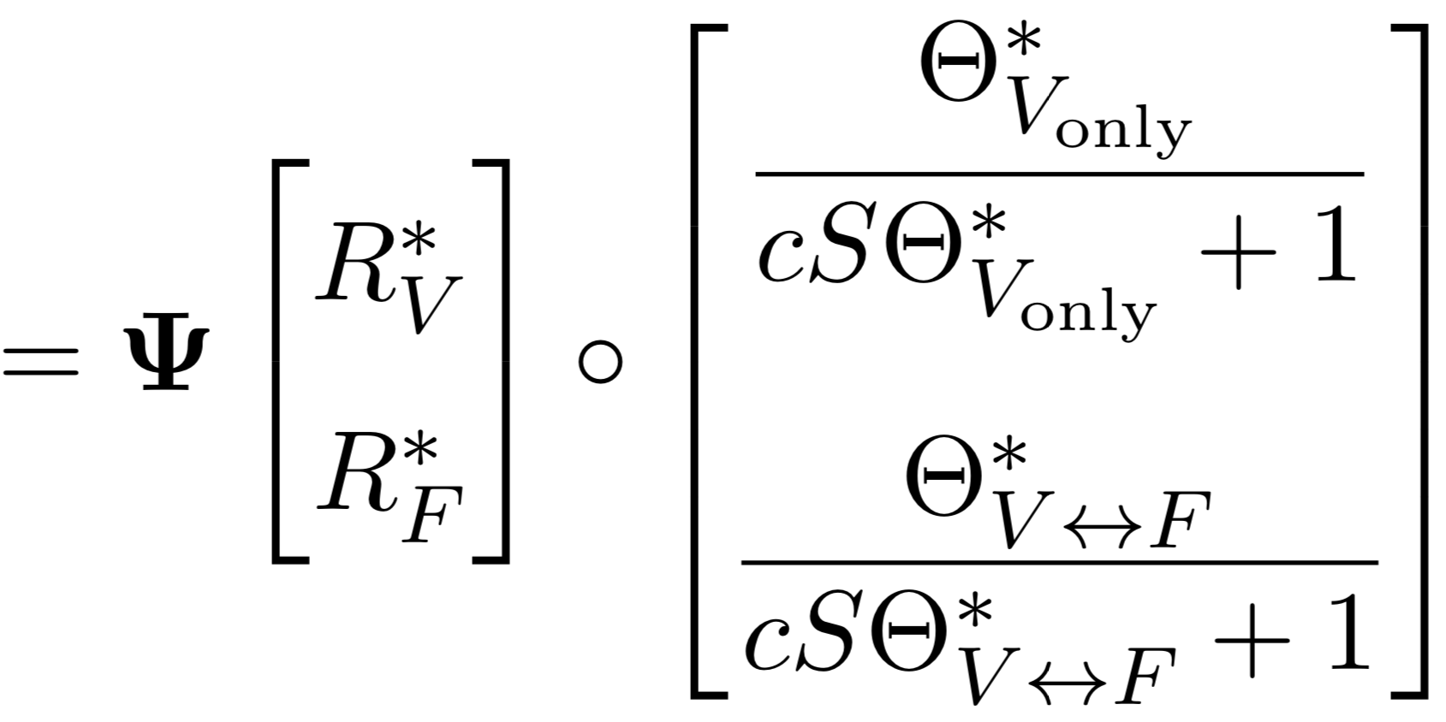



Simple Example: One Village, One Forest
Notes:
delete

Slide 79



Vectors of Variables

